Slide 1
Recognition of Antinuclear Antibody Patterns using Machine Learning
Gabriel Souza Pinto Medeiros
Ramon Galate Baptista Ribeiro

Slide 2
INTRODUCTION
01
DATASETS
02
NEURAL NETWORKS
IMAGE PROCESSING
TABLE OF CONTENTS
04
03
UNSUPERVISED CELL CLUSTERING
05
NEXT STEPS
06
Context and clinical relevance
Information on available datasets
Explanation on the machine learning algorithms used and their results
Image processing techniques investigated and applied
Clustering algorithm added to facilitate classification
Suggested continuation if this project moves on

Slide 3
01
INTRODUCTION

Slide 4
Autoimmune diseases
Largely prolific: 5% of total world population
Own body’s defenses mistakenly target itself
Antibodies target different external proteins
Antinuclear antibodies target nucleic proteins

Slide 5
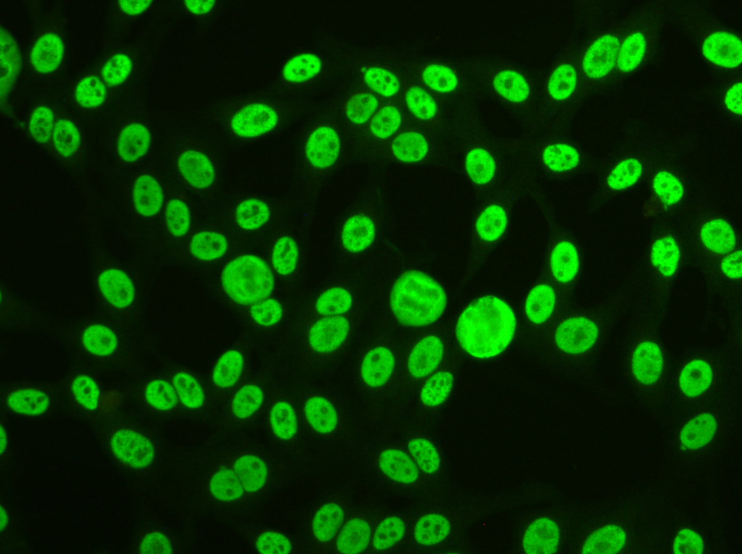
Relevance
What pattern is this?
Clinical evaluation can be insufficient for quickly diagnosing an autoimmune disease.
Detecting antinuclear stains might be an alternative
Constraints: manual detection and lack of qualified professionals

Slide 6
Relevance
What pattern is this?
Speckled (Mouchete) M0
Associated with specific diseases such as:
Lupus, Sjögren's syndrome, Polymyositis etc..

Slide 7
GOAL
CLASSIFICATION
Accurate and reliable enough to aid doctors diagnose
Model
Convolutional neural network integrated with image processing techniques for cellular isolation
SIMPLICITY
DETECTION
Simple enough for medical professionals to use
Able to isolate individual cells from larger image

Slide 8
02
DATASETS

Slide 9
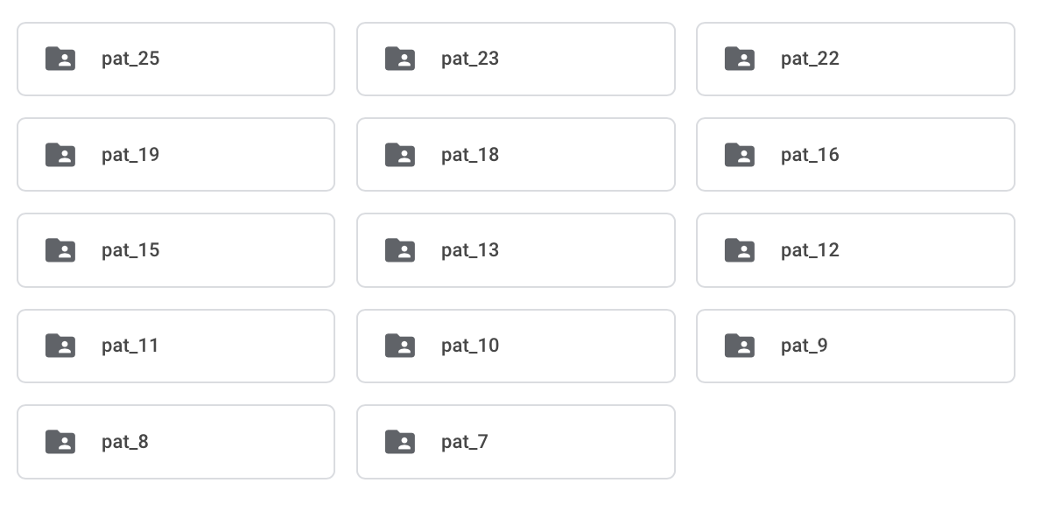
Patterns
Multi-Class
14 different unlabeled patterns
Each with 4-5 images
Images hand-picked by medical professional for clarity and relevance
Received initially

Slide 10
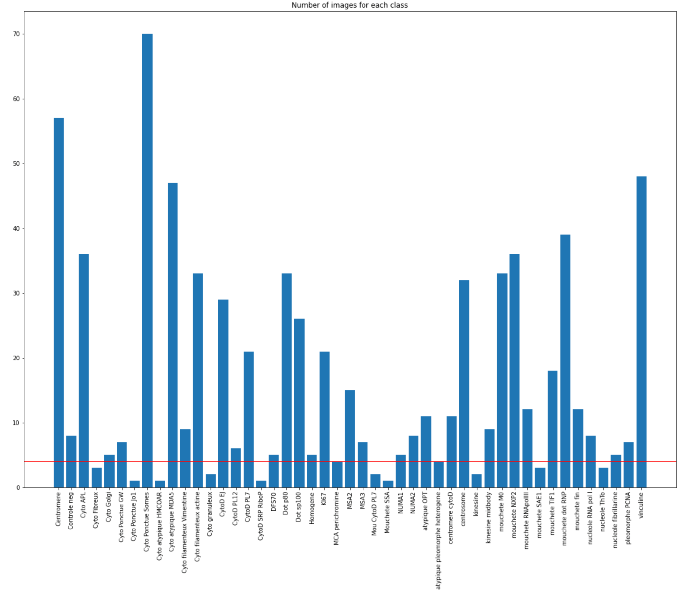
HEP-ANNOT
Multi-Class
47 different classes
Over 1000 images
High variance in image quantity
Can’t be used with pattern dataset
Received Initially

Slide 11
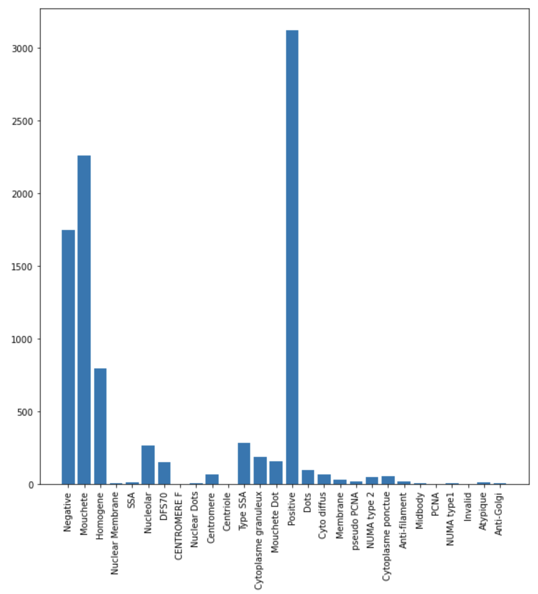
Additional Images
Multi-Label
25 different patterns
Very high inter class variance
Obtained in mid-january
Images with more cells
No visual inspection of images
Approximately 4880 images

Slide 12
Considerations
Which classification model is appropriate?
What are the true labels?
How can we use all datasets in one?
Are the datasets accurate enough to be used in diagnostic medicine?

Slide 13
03
IMAGE PROCESSING

Slide 14
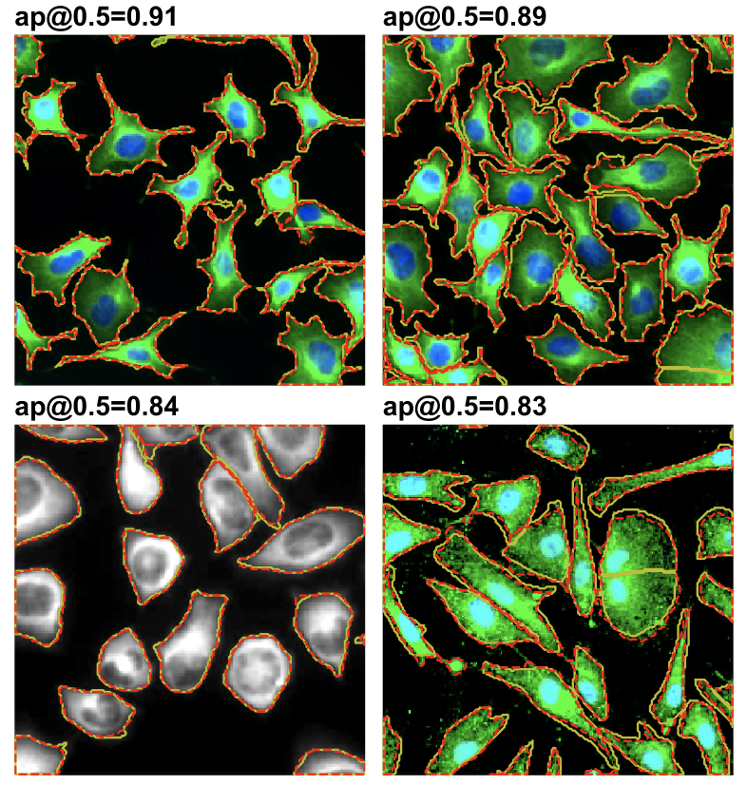
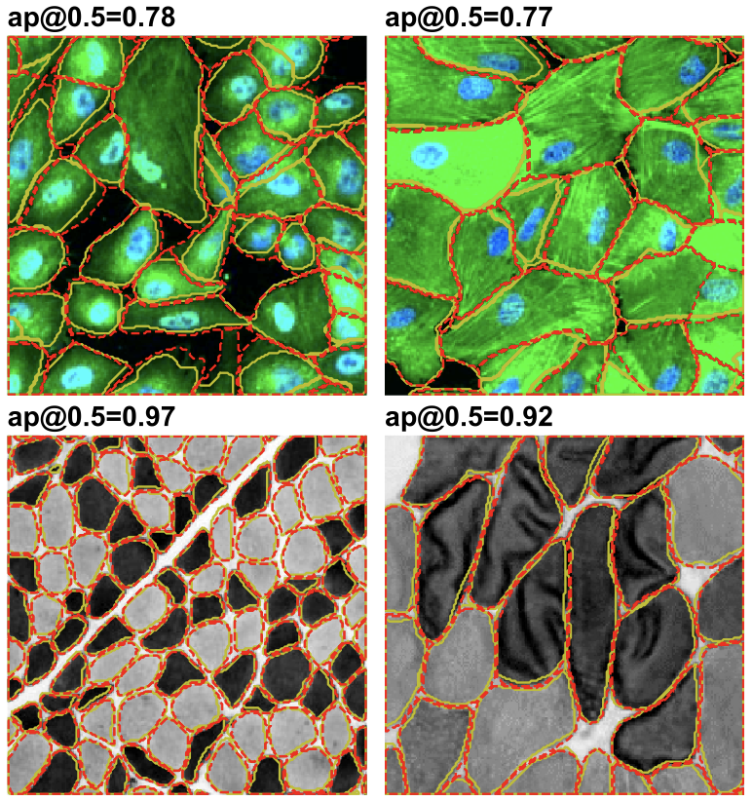
Cellpose
Generic cellular segmentation tool released in 2020
Takes photos of cells as inputs and outputs mask with same size
Parameters include:
Expected average cell diameter
Different channels for different parts of the cell
Images taken from paper:
https://www.biorxiv.org/content/10.1101/2020.02.02.931238v1

Slide 15
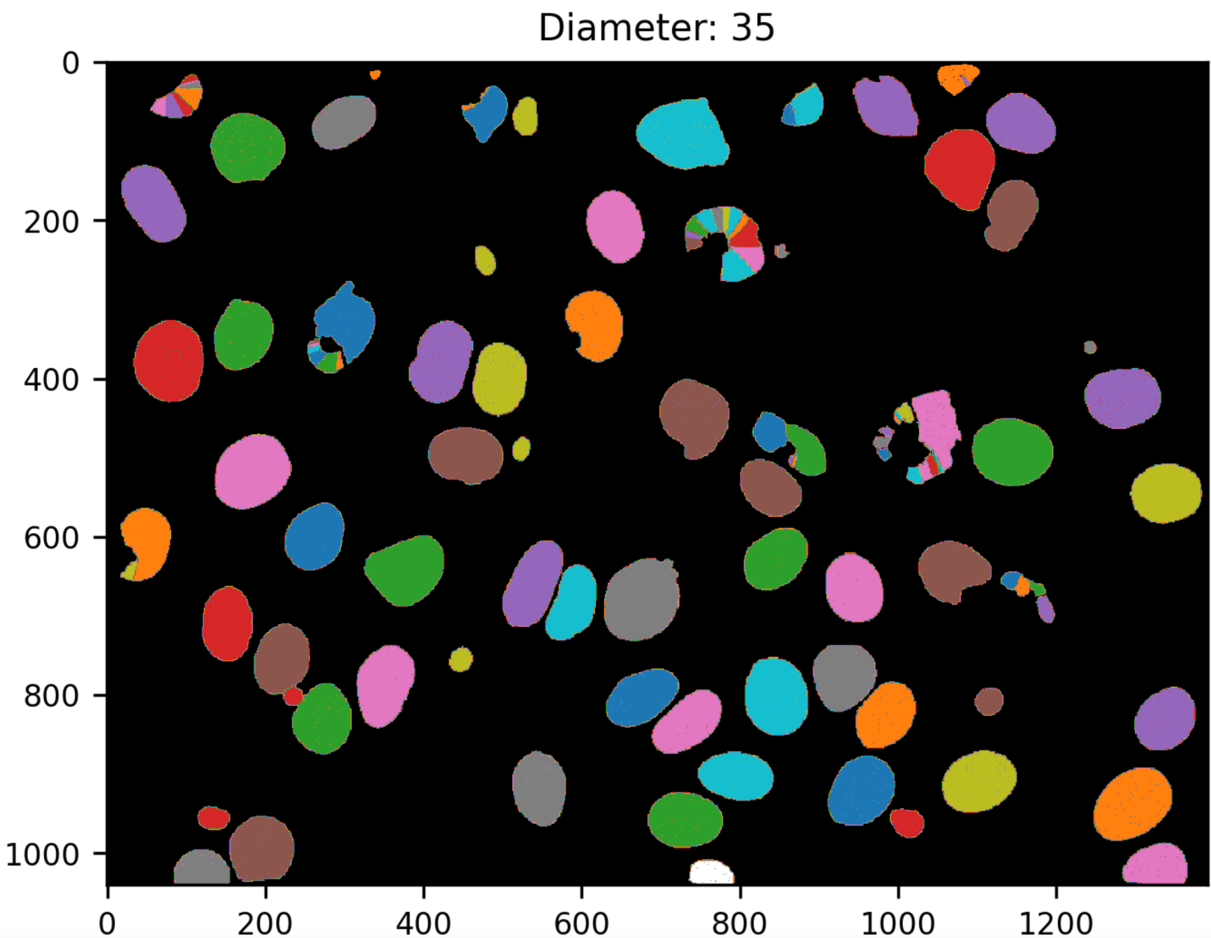
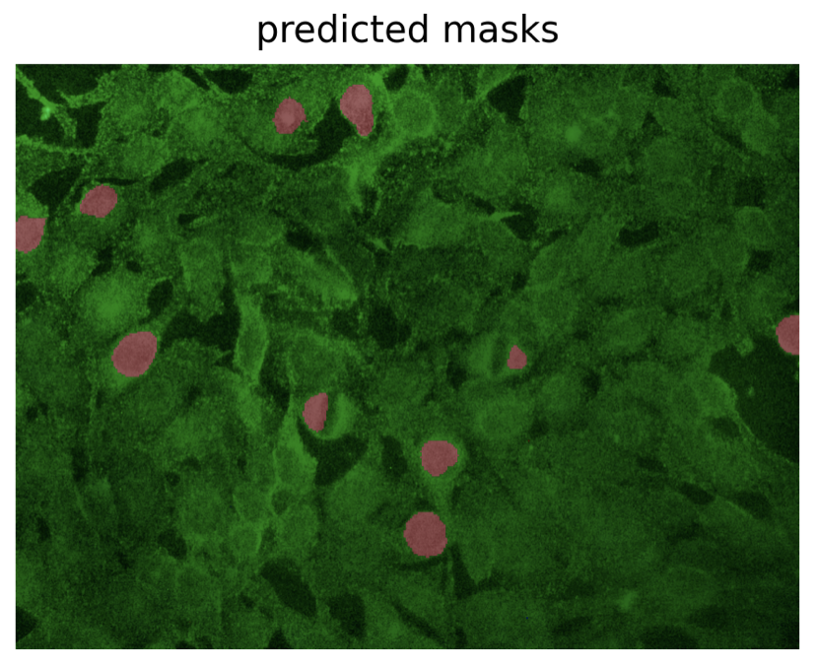
Difficulties
Consistent results were hard to obtain
Initial trials were done using Cellpose’s automatic diameter calculator or a fixed diameter
While both were able to present some results, neither were perfect
Cellpose would sometimes over segment certain cells, or have a tough time with predominantly cytoplasmic patterns

Slide 16
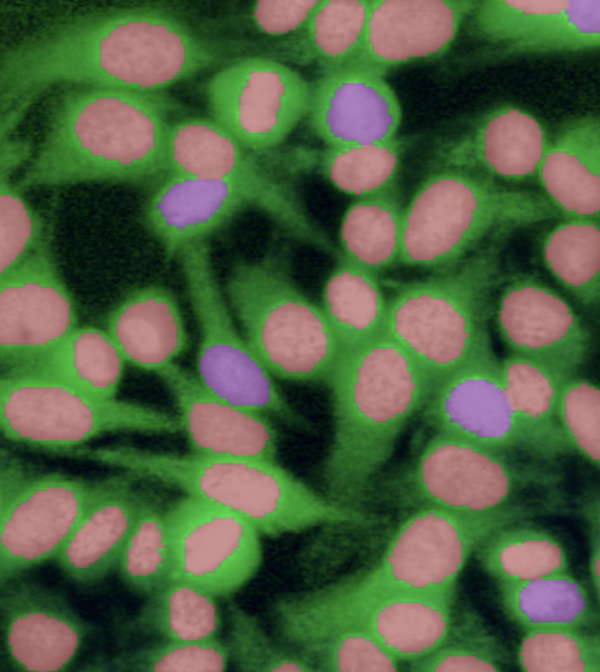
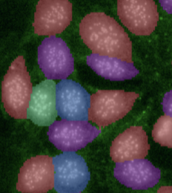
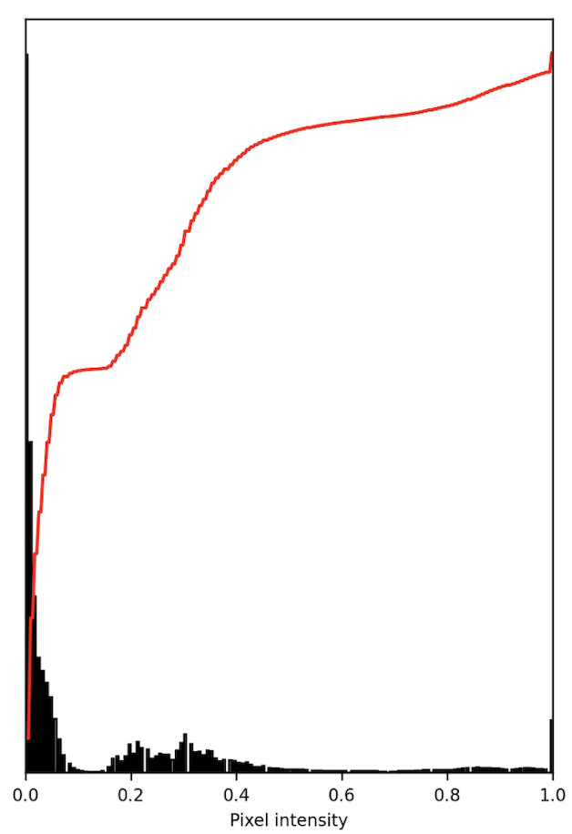
Segmentation Pipeline
NUCLEUS SEGMENTATION
IMAGE PROCESSING
CYTOPLASM SEGMENTATION
Image processing and and channel separation to aid cellpose in classifying each cell in their entirety
Usage of cellpose to create masks to obtain each cell’s nuclei
Usage of cellpose to obtain masks containing not only the nuclei, but also each cell to their entirety

Slide 17
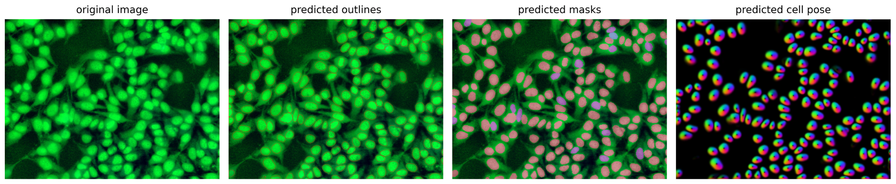
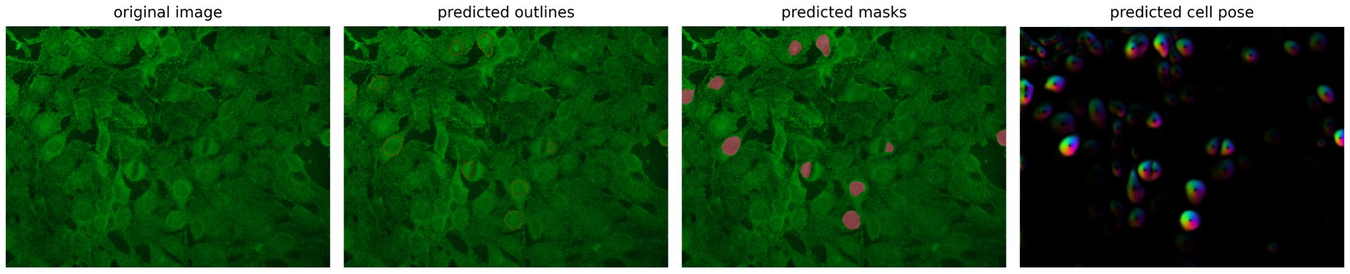
Nucleic Segmentation
Isolating only the nuclei
Utilizing Cellpose’s mode for only nucleic selection
Fixed nucleus diameter at 60 px
Used images on only one channel
Results were mostly good, but yet insufficient
Top: Centromere pattern
Bottom: Fibrous cytoplasm pattern
Left: Original image
Right: predicted nuclei

Slide 18
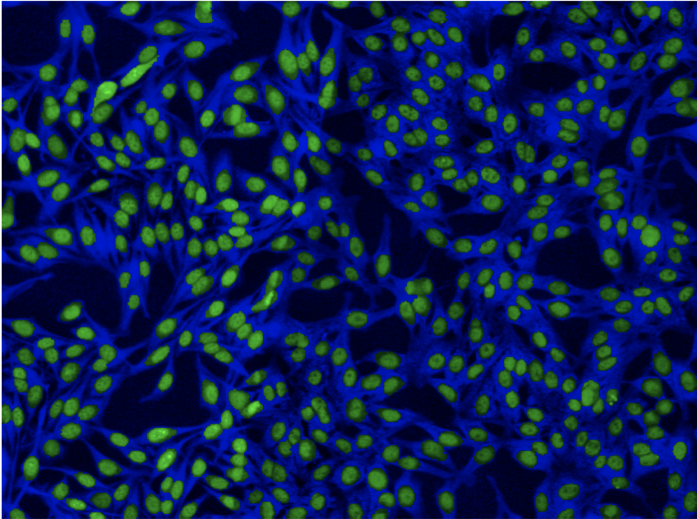
Image Processing
Separation from remainder of image
Nucleus mask separated nucleus from image
Placed nucleus on green and remainder on blue channels
Used image equalization on channels independently
Now it is possible to use Cellpose to its fullest extent

Slide 19
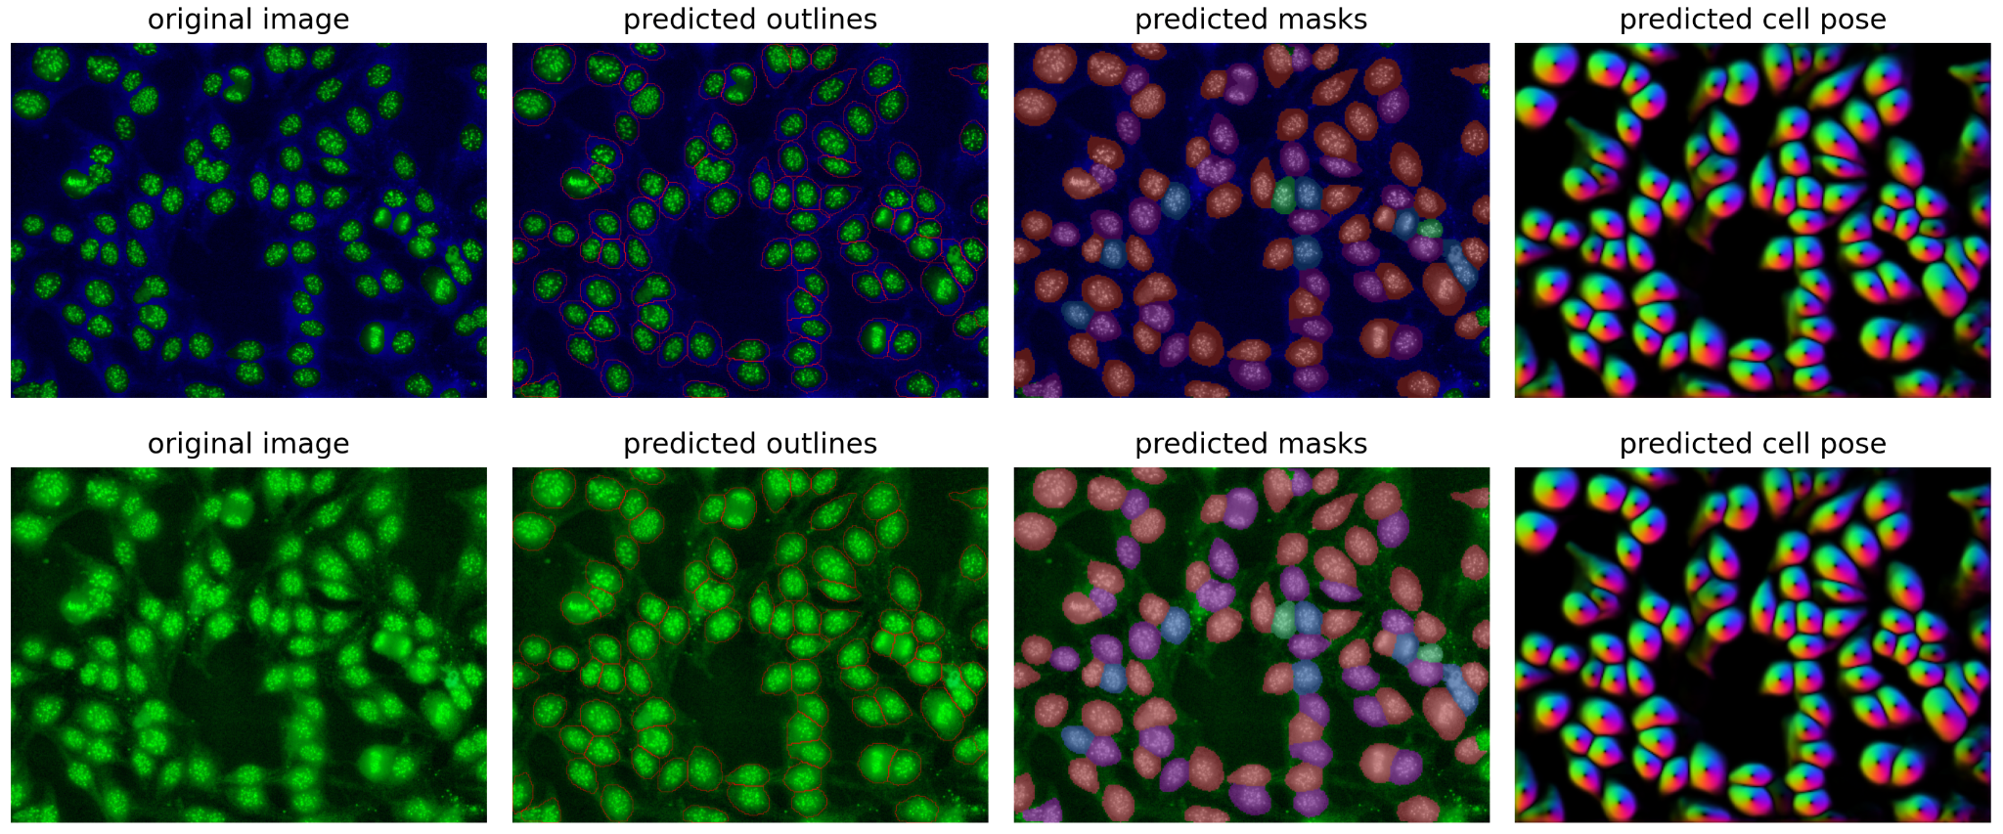
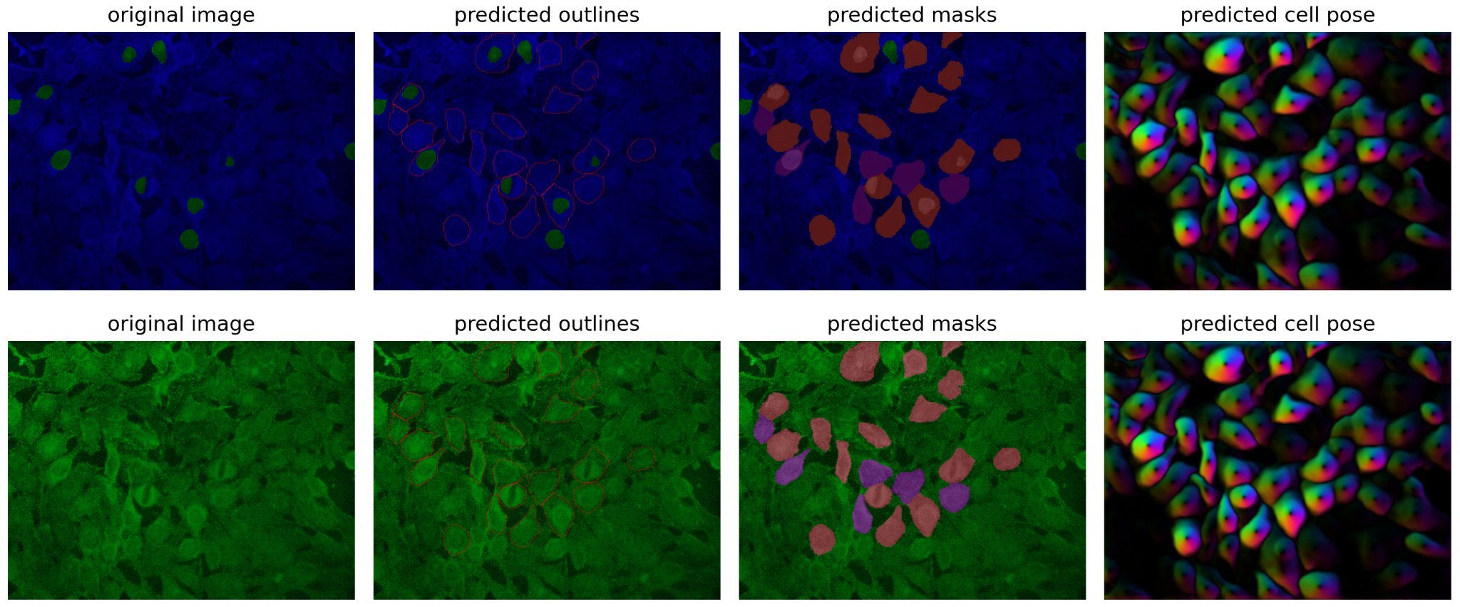
Cytoplasmic Segmentation
Capturing the entire cell
Utilizing Cellpose’s mode for cytoplasmic selection
Fixed cell diameter at 145 px
Used varying diameter for cells with smaller nuclei
Results were a vast improvement upon everything obtained before
Top: Centromere pattern
Bottom: Fibrous cytoplasm pattern
Left: Processed image
Right: predicted nuclei

Slide 20
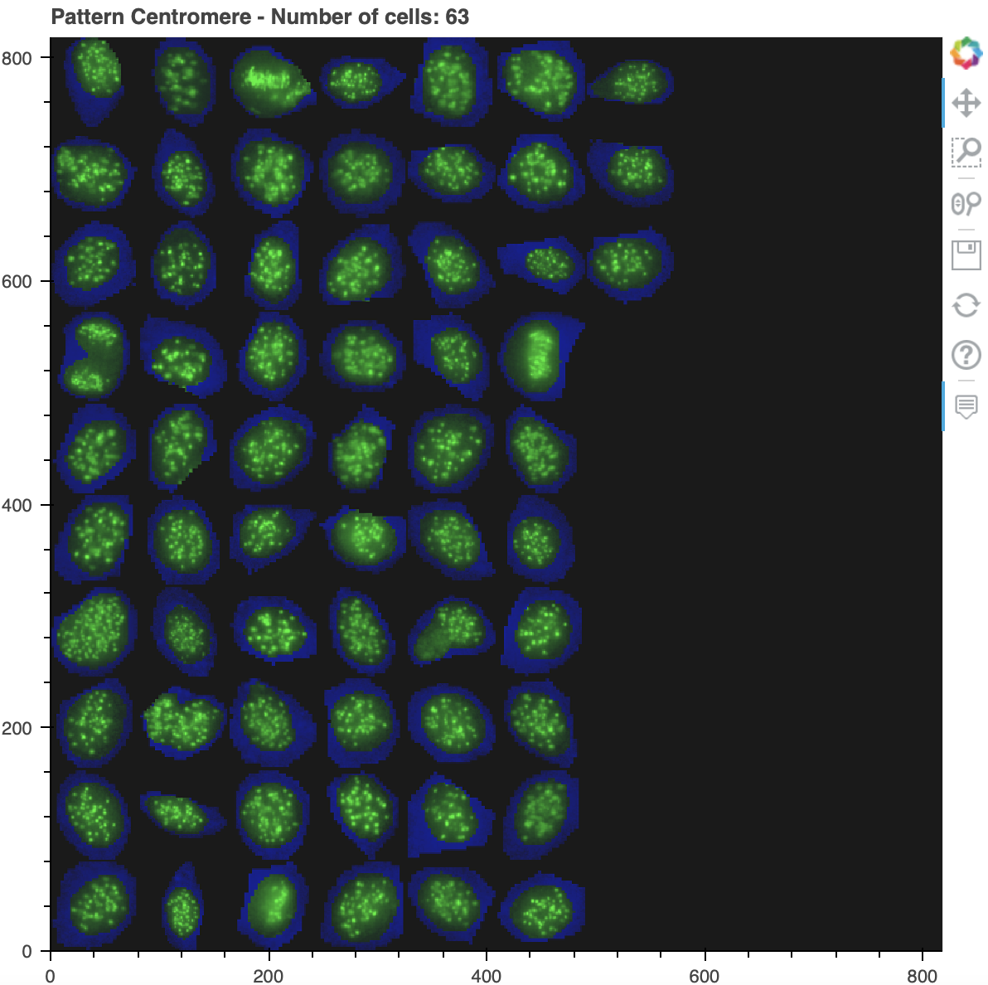
Final segmentation of Centromere Class

Slide 21
04
NEURAL NETWORKS

Slide 22
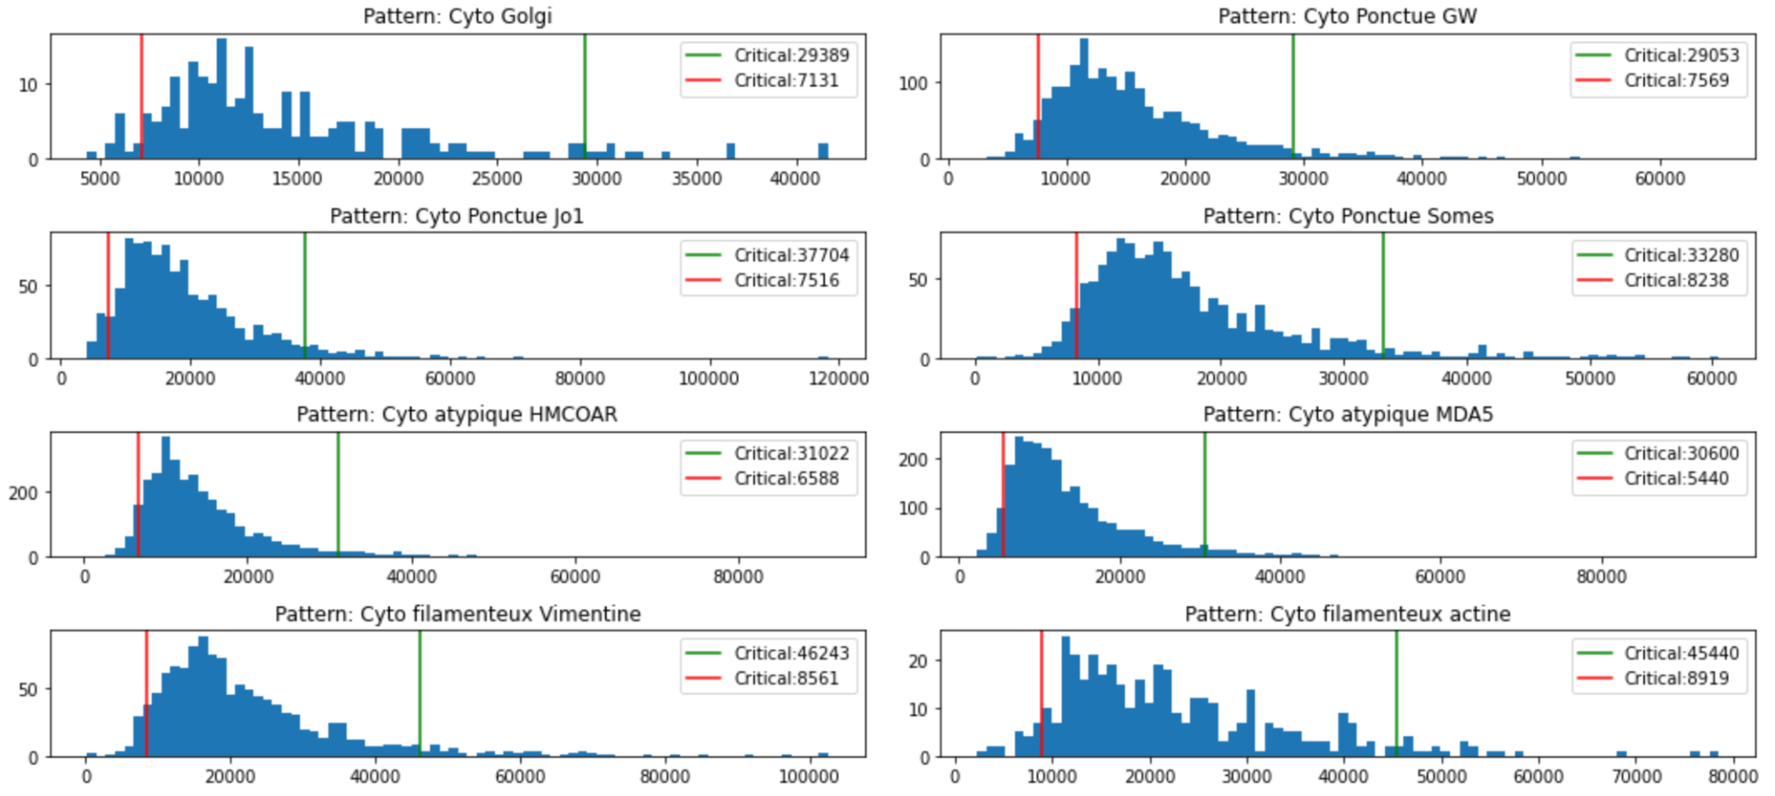
Pre Processing
Making each cell uniform for NN input
Each cell has varying sizes and information
NN demands fixed input size
Partial cell segmentation: percentile filtering

Slide 23
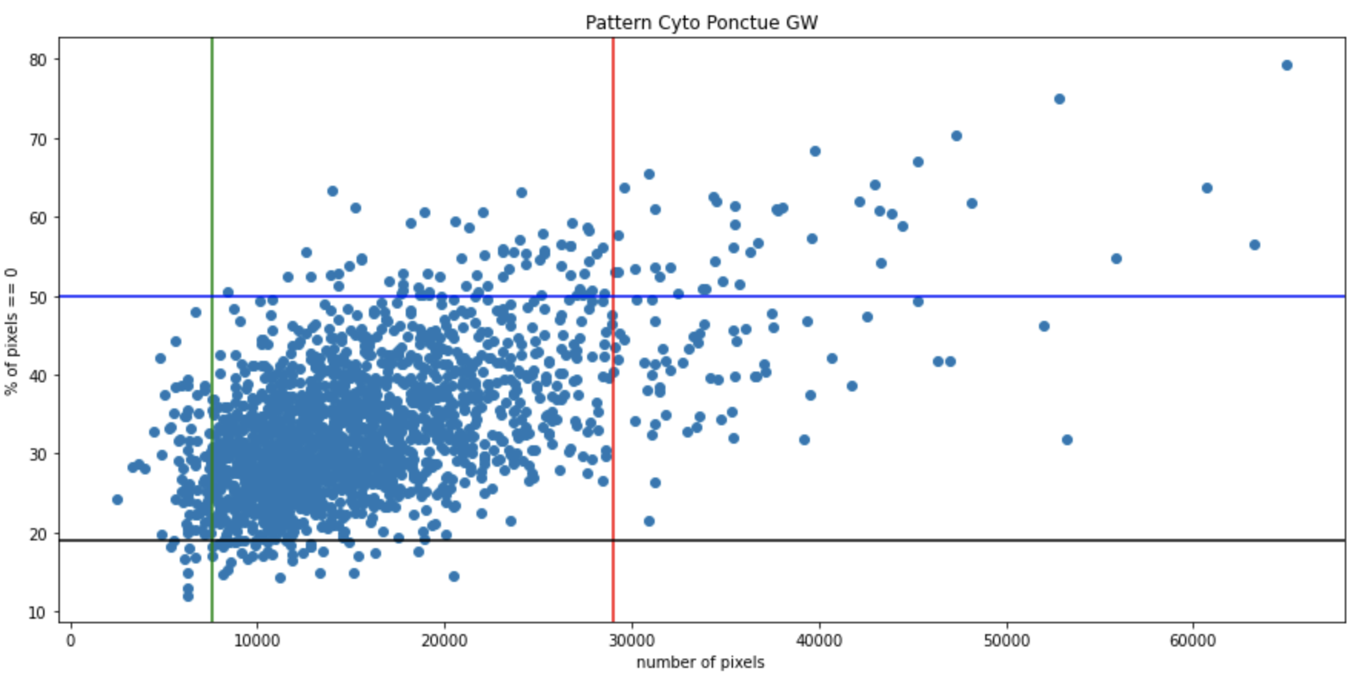
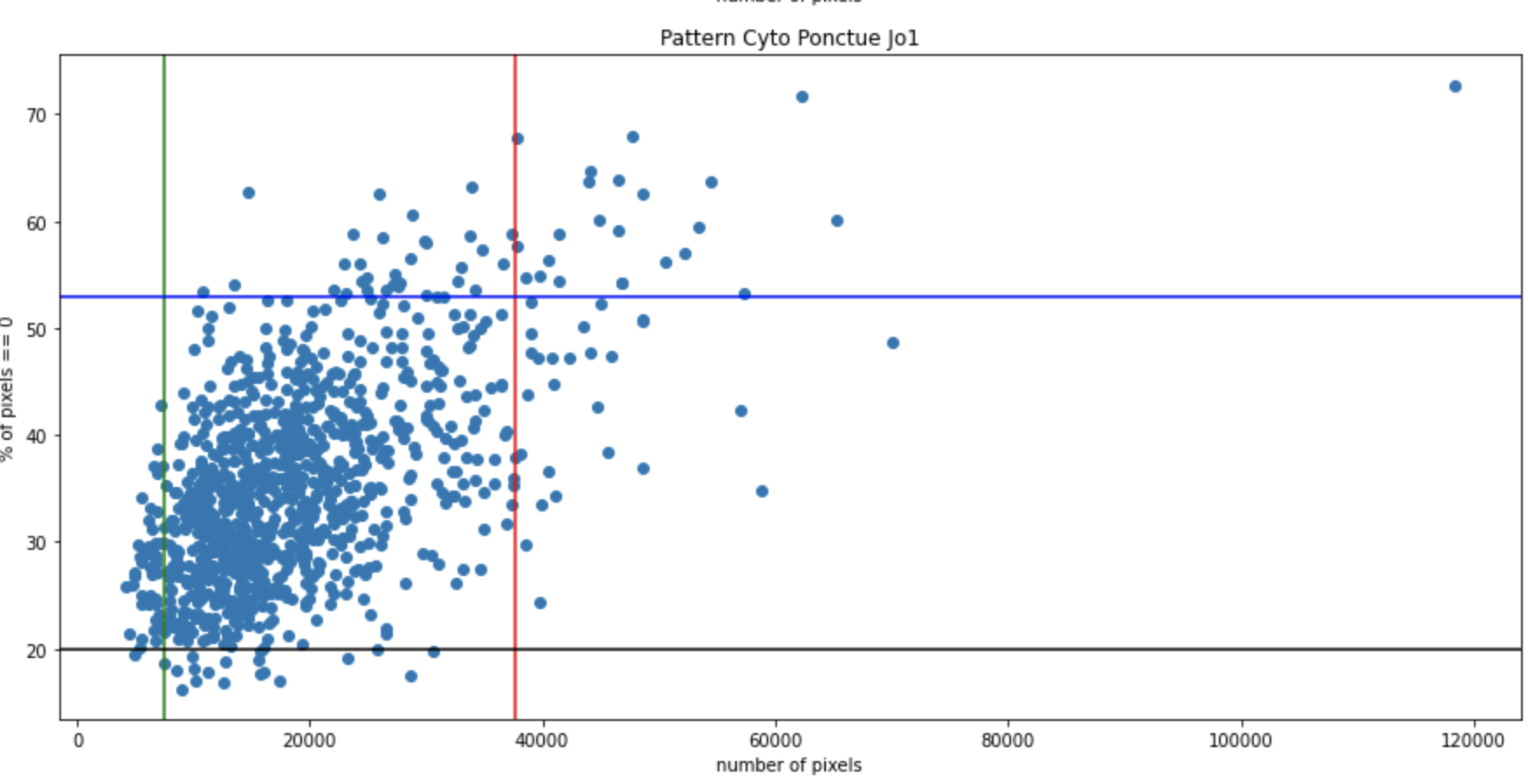
Pre Processing
Making each cell uniform for NN input
Each cell has varying sizes and information
NN demands fixed input size
Partial cell segmentation: percentile filtering
Noise selection: black pixel filtering
Resize: upscaling and downscaling
Data augmentation: flipping

Slide 24
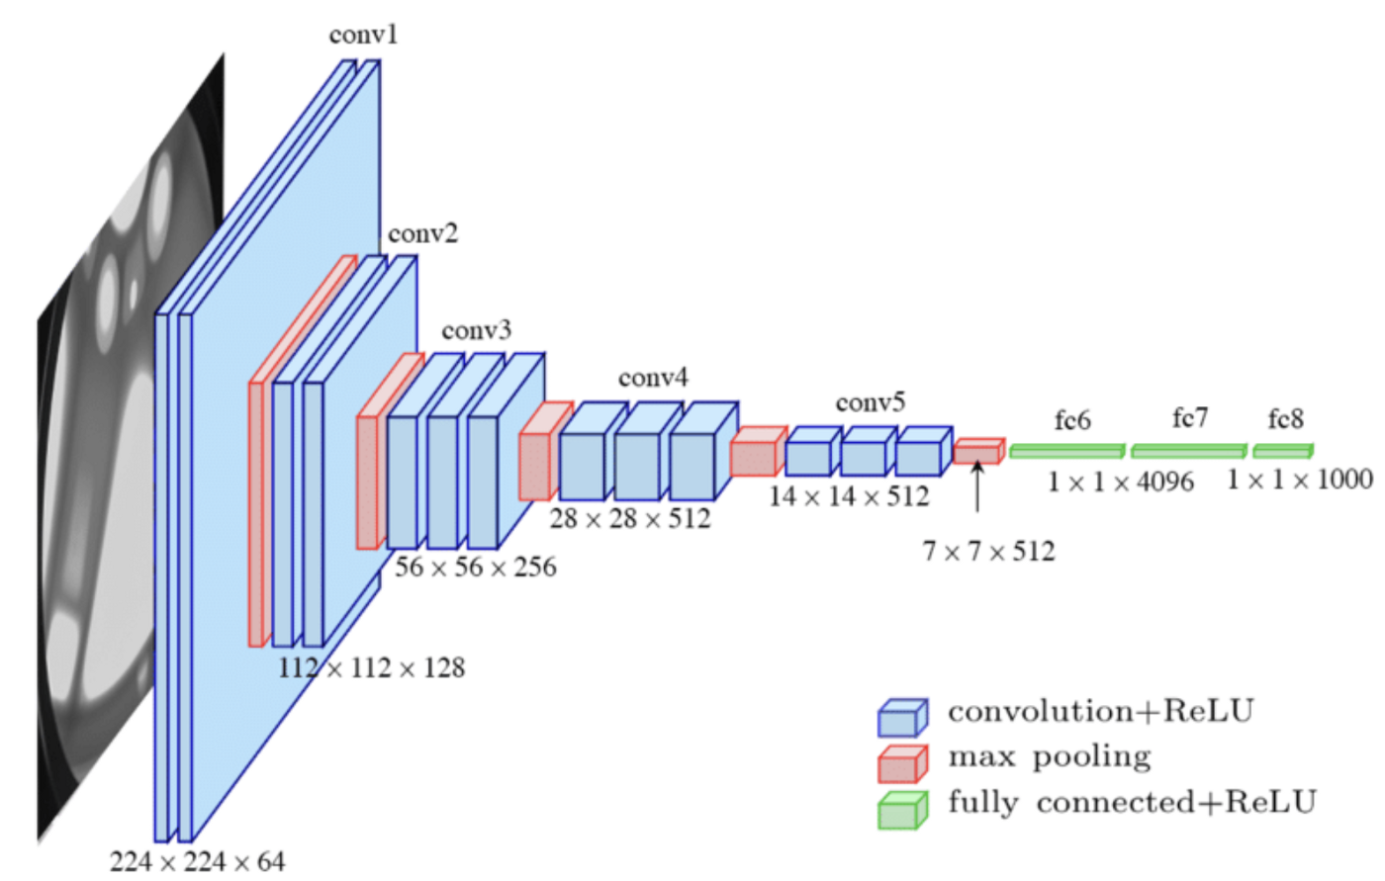
Transfer Learning
Used VGG16
Reuses model created for different task
Used VGG16
Added two deep layers
Added a dropout layer

Slide 25
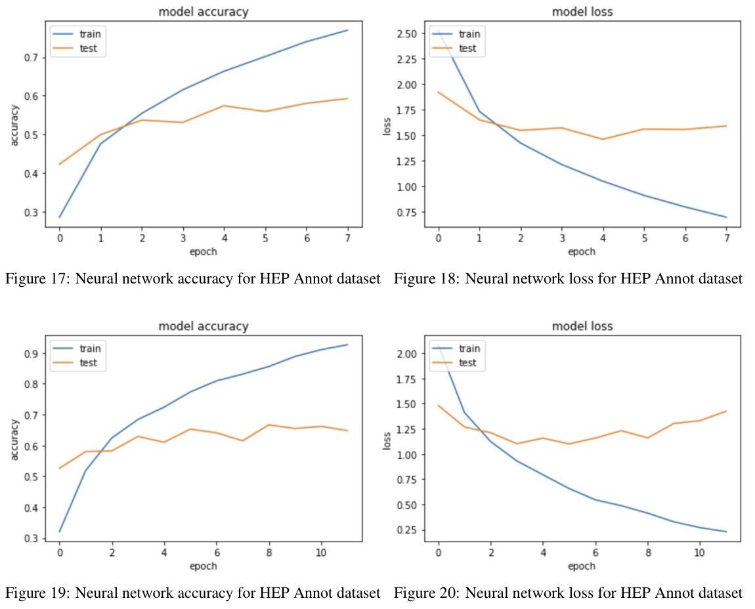
Results
Decent results per cell, but some signs of overfitting
Results per cell, but classification is per image
Doesn’t need to be 100% accurate
Showed signs of overfitting despite dropout layer
Possible causes:
Lack of non augmented data
Inherent classification problem

Slide 26
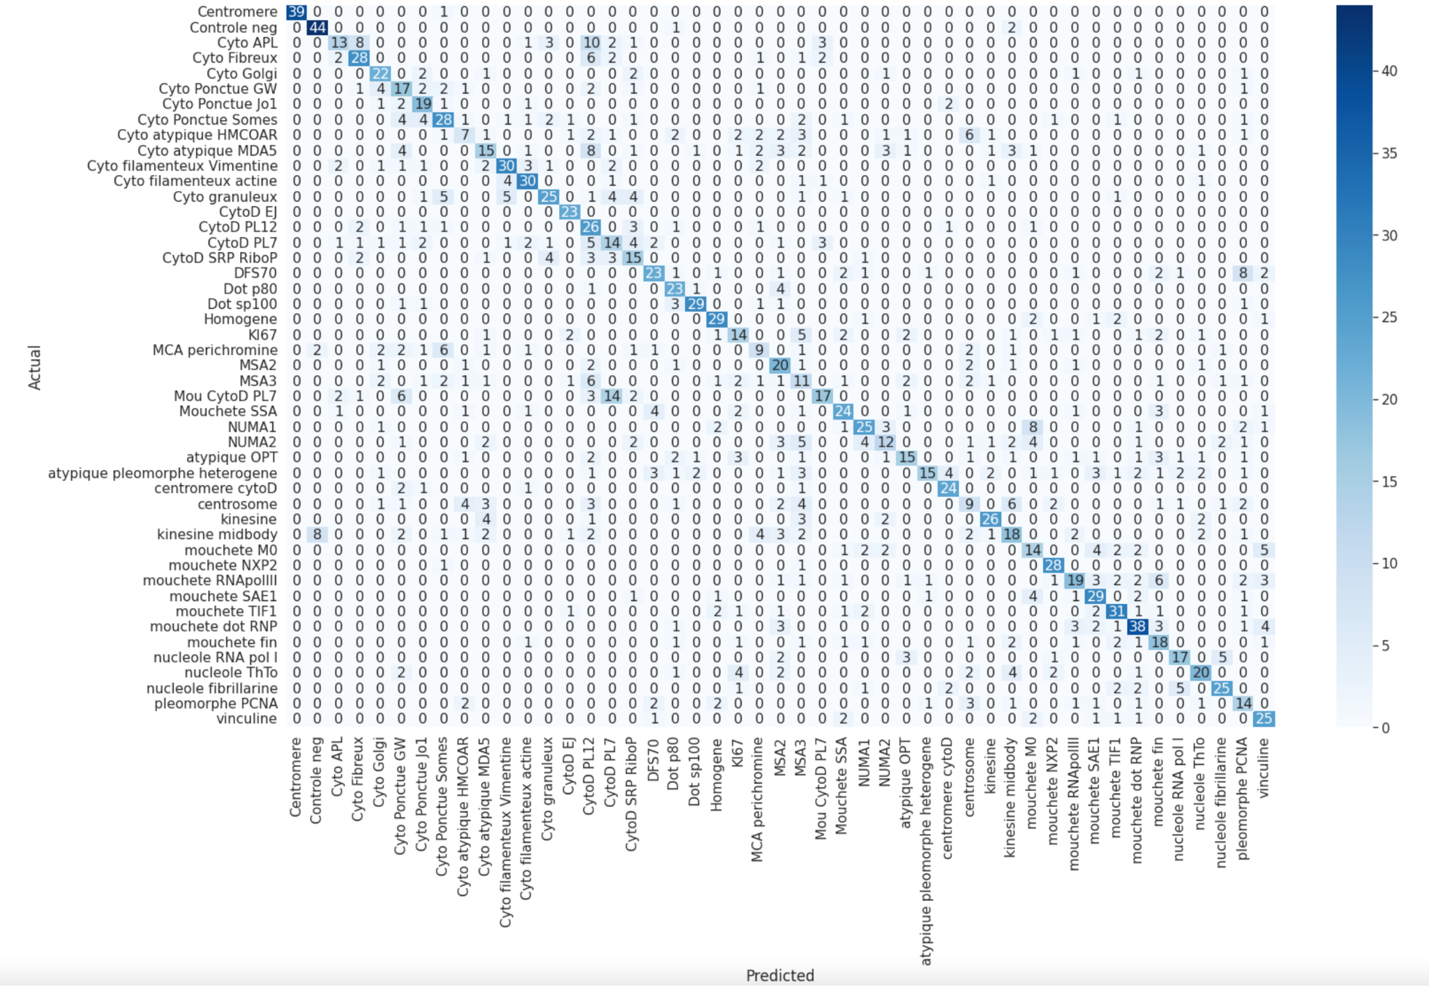
Error Matrix

Slide 27
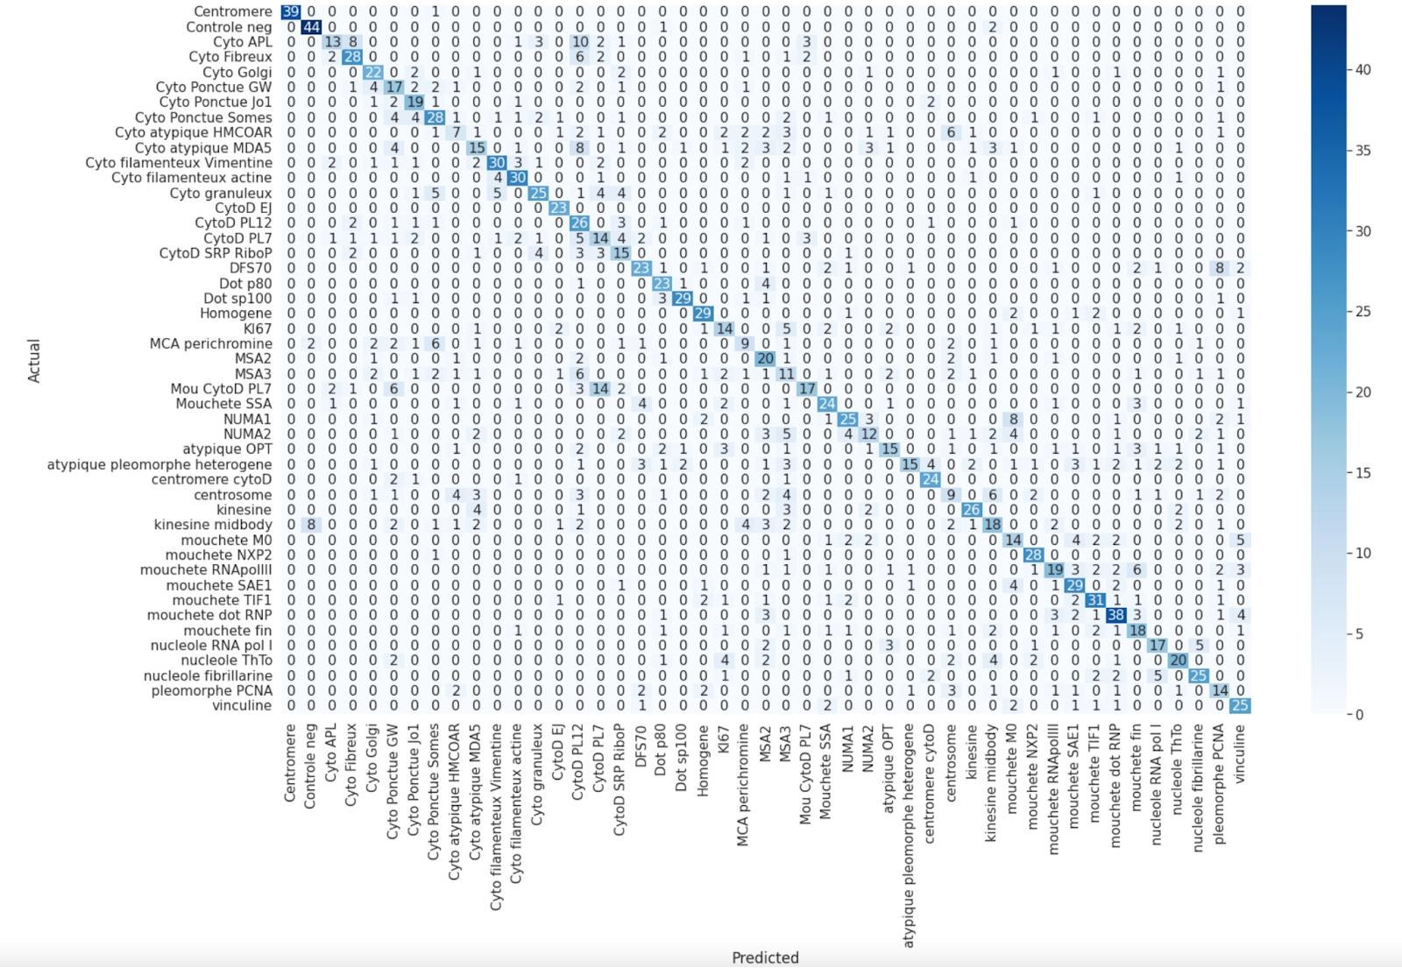
Error Matrix

Slide 28
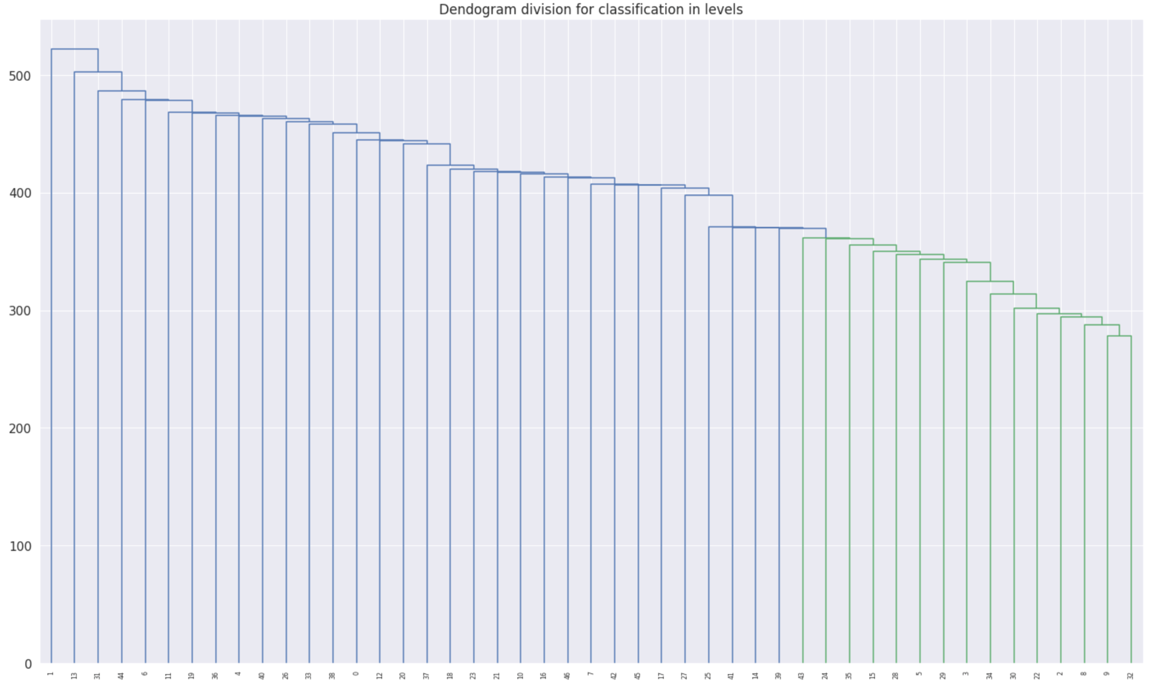
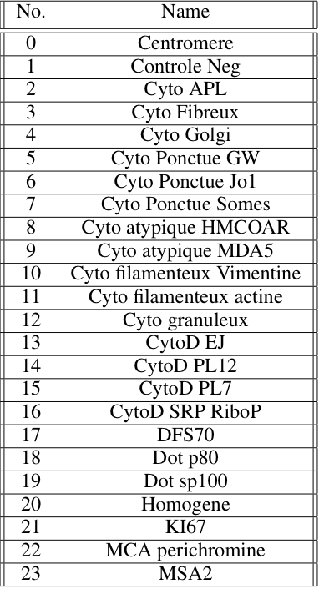
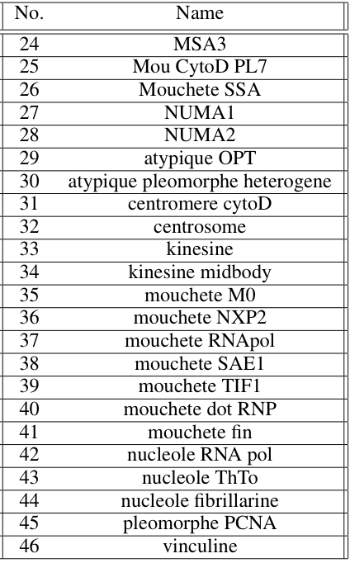
Dendogram

Slide 29
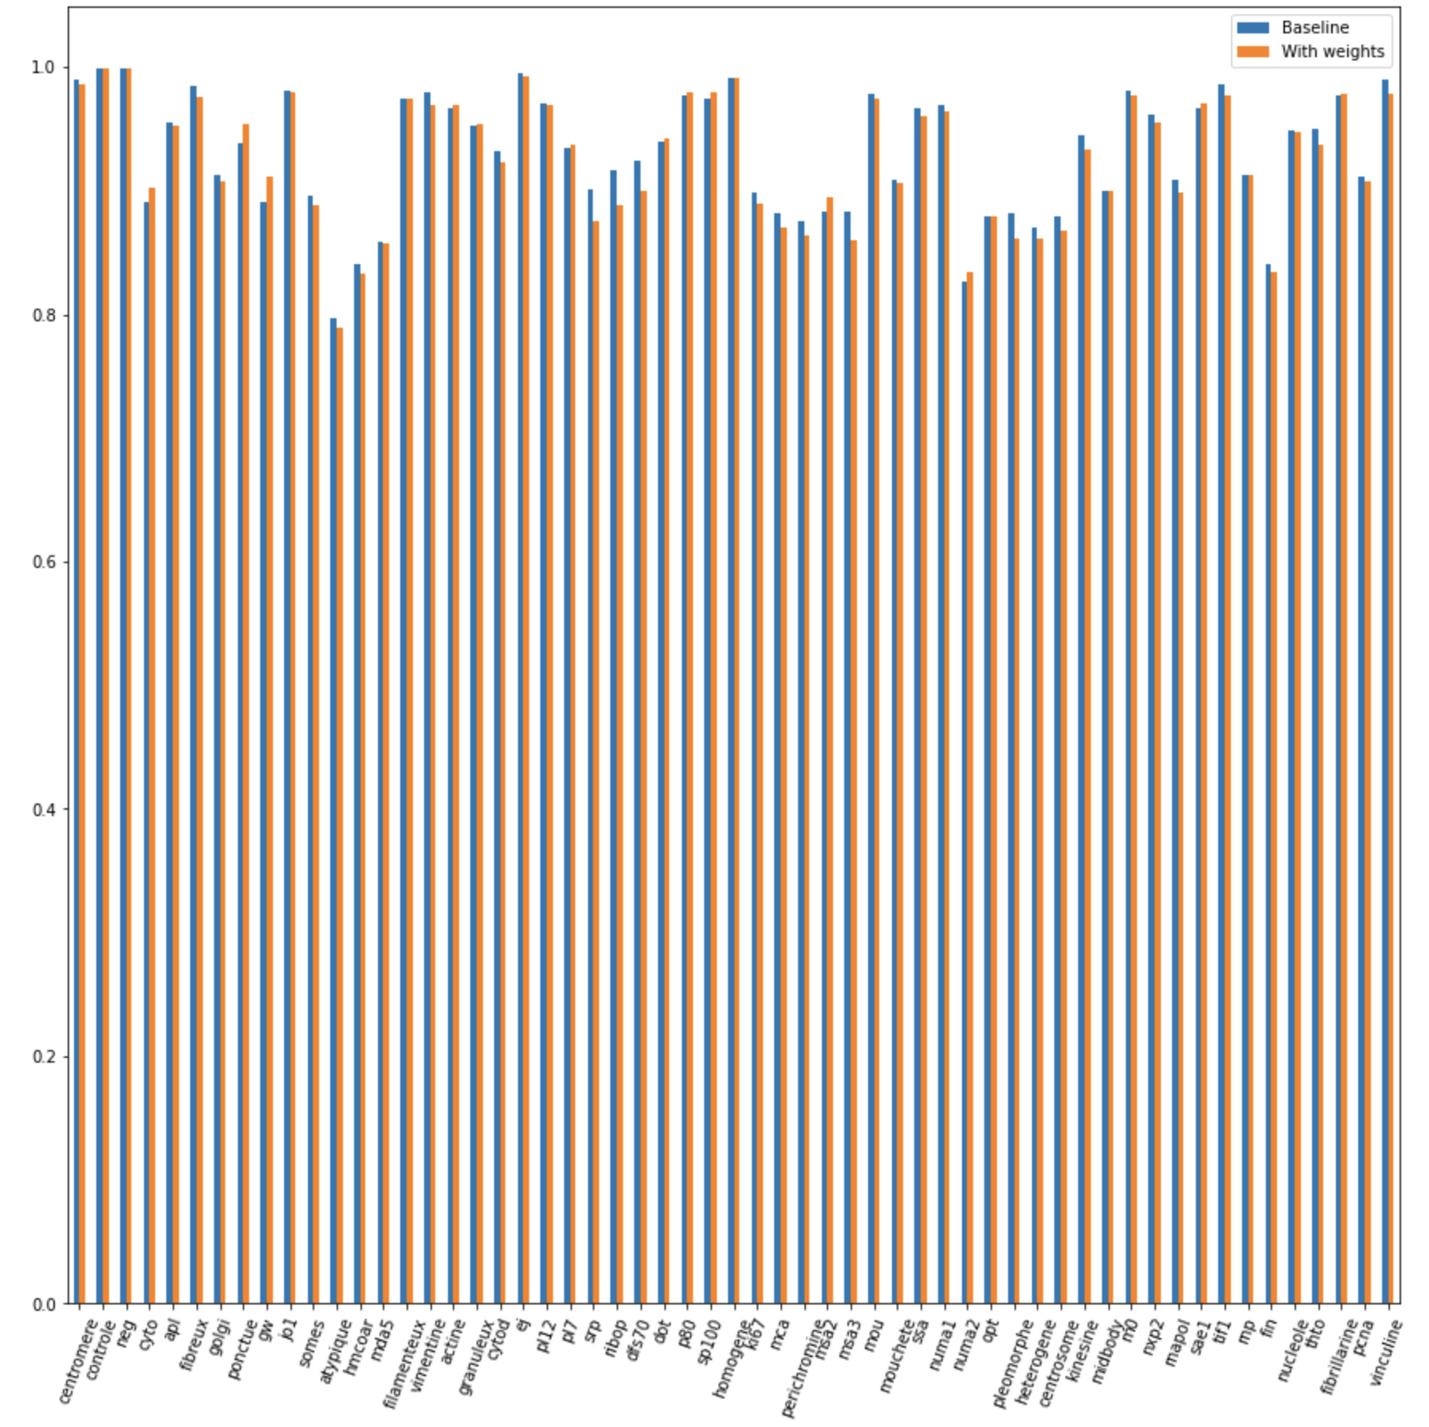
Multi-label Classification
Parsed Hep Annot class names to serve as labels and classified that
Same model far better results
Binary relevance method
Baseline outperformed weights overall
Has tendency to not estimate any label
AUC ROC accuracy:
Probability that positive sample is ranked ahead of a negative one

Slide 30
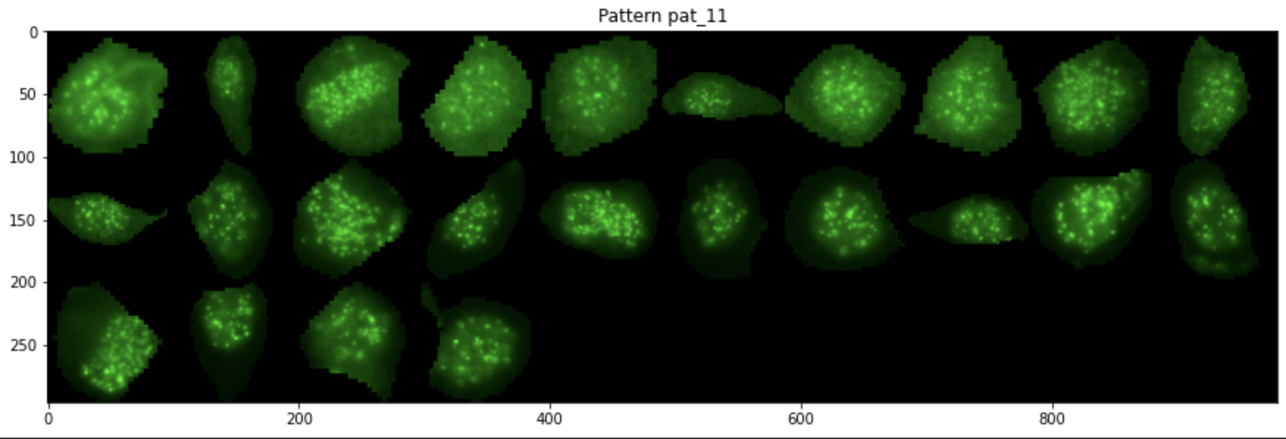
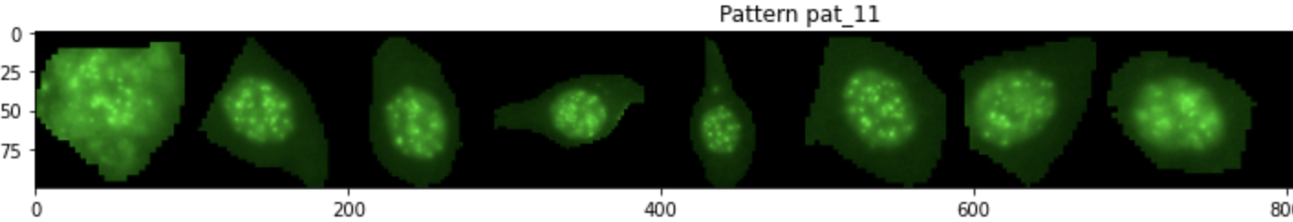
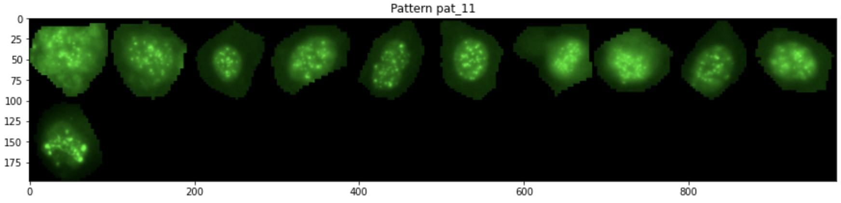
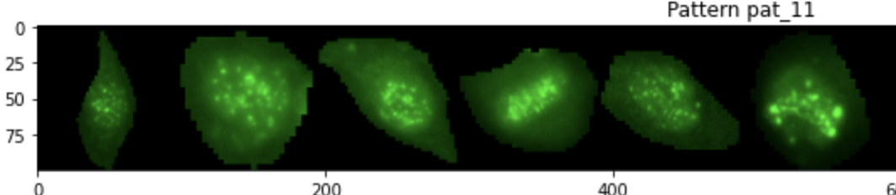
Multi Label classification
Centromere - 24
Mouchete - 8
RNApol - 11
Nucleole - 6
Total cells - 125

Slide 31
Final considerations
Multi-class classification seems conceptually flawed
Multi-label classification presented better results initially
Multi-label classification estimates 0s over 1s
This is essentially an outlier detection problem

Slide 32
05
UNSUPERVISED CELL CLUSTERING

Slide 33
Motivations
Some classes are classified by a minoritarian cluster of cells
The current multi-label classification weights all cells equally
Avoids the need to filter images and lose data

Slide 34
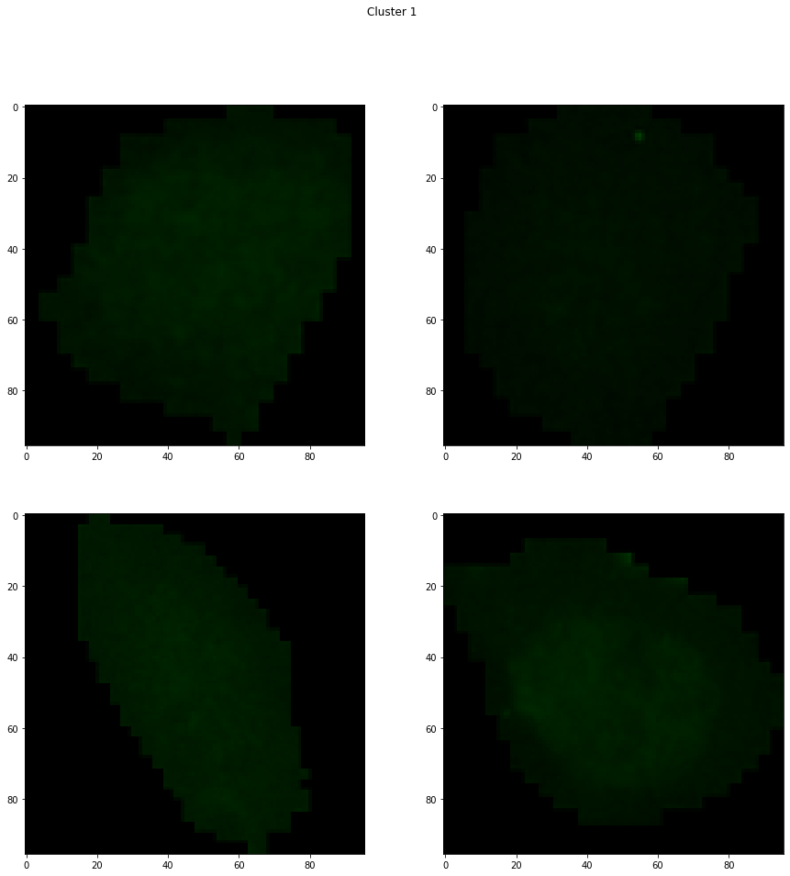
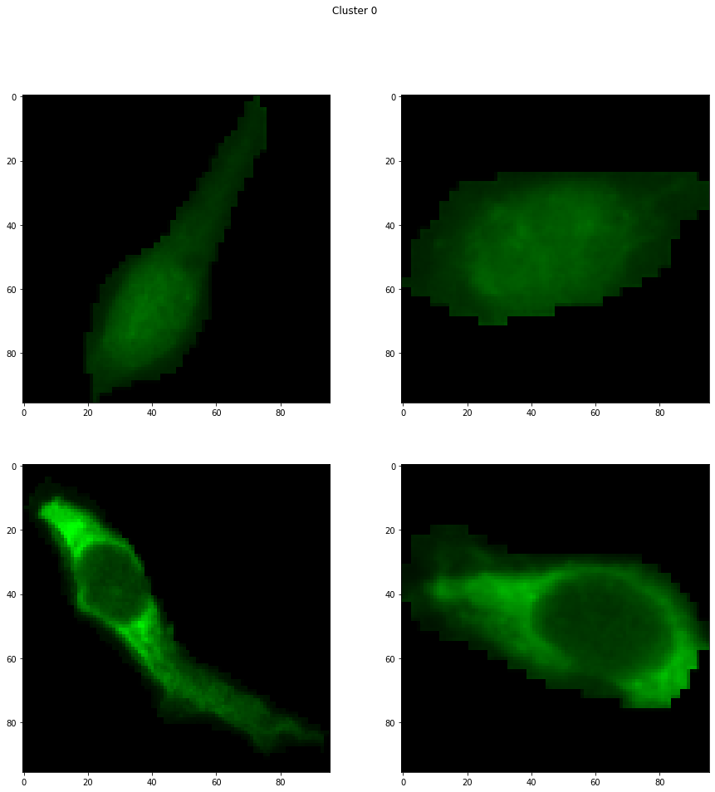
Example: Cyto atypique MDA5
Cyto atypique
MDA5
Represents 0.5-4% of cells
Are differentiated by gray level and shape
Majority of cells

Slide 35
Difficulties
Our datasets had varying contrast between inter-class images
The dataset is high dimensional
Clustering is used on similar non-linearly separable cells

Slide 36
Clustering pipeline
Feature space transformation
KPCA dimensionality reduction
K-means ++
Feature space transformation,
using VGG’s pre-trained NN
Here we use the nystrom approximation to achieve linear complexity in the kernel computation
Identifies n clusters from the dementionaly reduced data

Slide 37
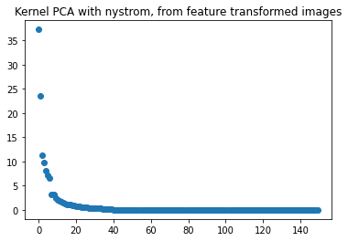
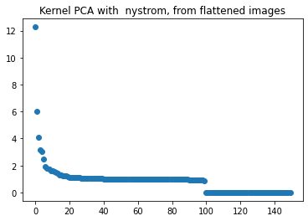
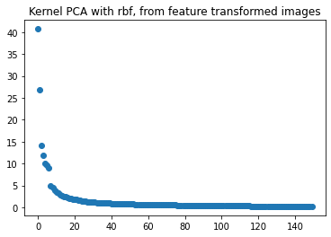
KPCA
eigenvalue study
The feature transformation gives better results
The nystrom approximation has almost no information loss

Slide 38
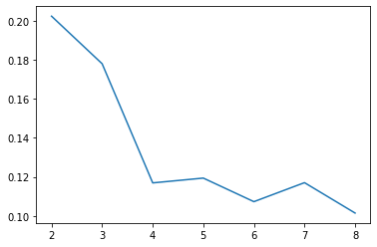
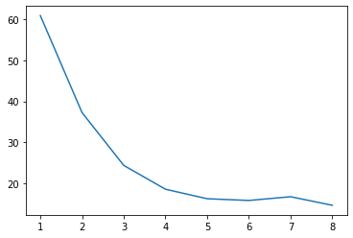
Optimal number of clusters
The Elbow Method
The Silhouette Method
Choose the k for which the value first starts to stabilize
A high value is desirable and indicates that the point is placed in the correct cluster.

Slide 39
Clustering future needs
Check with Dr. Miyara which cluster refers to each label
Check which clusters have the highest correlation for images with the same labels
Retrain the multi-label classification with the clusters found
Notes:
With NN, RNNS or Transformers to classify

Slide 40
06
NEXT STEPS

Slide 41
How to continue
Create with Dr. Miyara a well defined group of labels
Manually check database with medical professional
Integrate all datasets within the same labels
Integrate unsupervised cell clustering to the pipeline
Retrain multi-label while addressing some of its flaws
Research better multi-label methods for imbalanced datasets
Create a classification method for an entire image from the classification data of its cells
Notes:
With NN, RNNS or Transformers to classify

Slide 42
QUESTIONS?

